Slide 1
Event website
SEIS 752
Team 1 Project
Professor: Lloyd
Student: Qiwen Hu
Zhaoyang Liu

Slide 2
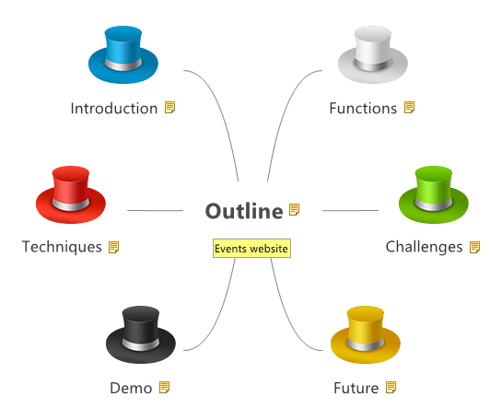
Outline

Slide 3
Introduction
This project is to make an event web page that displays the events and their details. Users can check all the upcoming events in categories, include sport games, great movies leasing, and music events. In account page, users are able to register an account, sign-up locally or using google and facebook account.

Slide 4
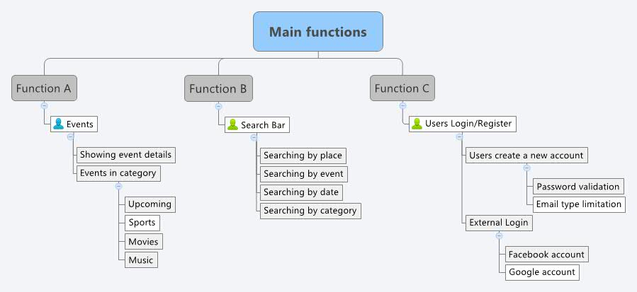


Main functions of the project
‹#›

Slide 5
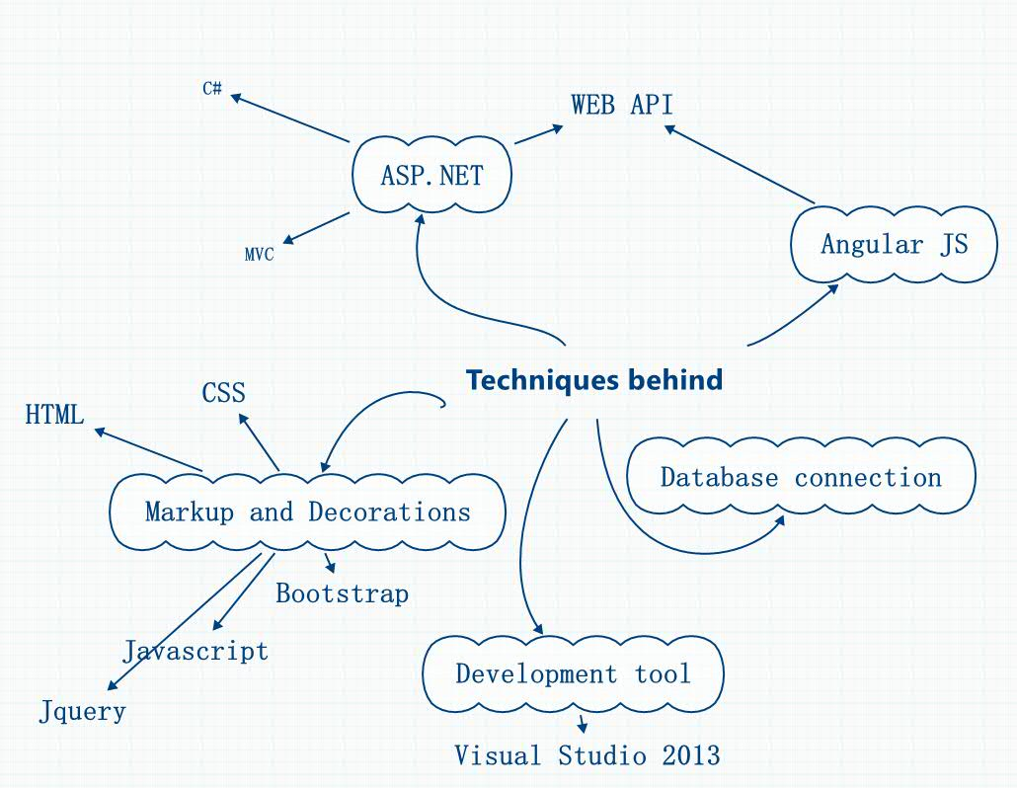
Techniques behind

Slide 6


AngularJS

Slide 7
Challenges

Slide 8
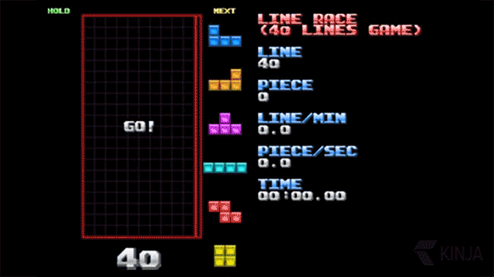
Challenges
How web experts build a website:

Slide 9

Challenges(cont.)
How we built our website:

Slide 10
Challenges(cont.)
Everything became as a mission
Think easy – Perform hard
How to use tools to realize Functions
Connection between back-end and front-end

Slide 11
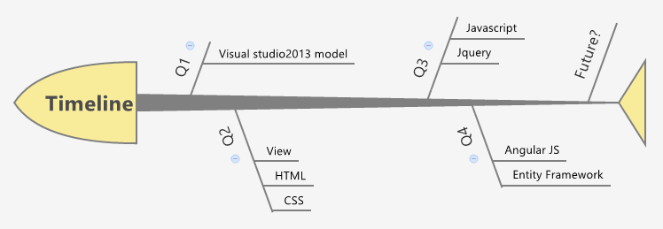
Fish-bone Diagram

Slide 12
Demo…
https://localhost:44301/Index.html

Slide 13
What we can improve in the future
Provide relatively complete function in User account page
Add functions for data transition
Make website more reliable(IE, Chrome, Firebox…)
Page Decoration
Publish to external domain

Slide 14
Reference
https://angularjs.org/
http://www.asp.net/
http://weblogs.asp.net/
http://www.codeproject.com/

Slide 15
Questions?

